Slide 1
DATABASE SYSTEMS

Slide 2
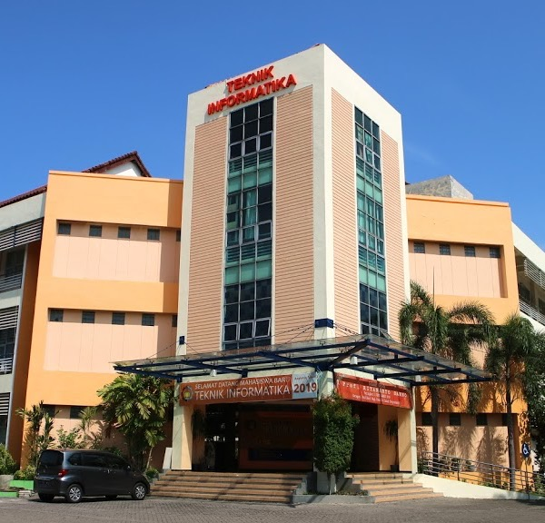
Syllabus & Introduction
Database Systems
Tim Pengajar SBD Semester Gasal 2020/2021

Slide 3
Agenda
Deskripsi Mata Kuliah
Capaian Pembelajaran
Rencana Pembelajaran
Evaluasi
Referensi
Dosen & Asisten Kelas
Materi

Slide 4
Course Description
Course Code : EF234104
Course Name : Database Systems
Credits : 4 credits
Students will learn about how to model data and information in the form of concept diagrams and physical diagrams and apply them to a database in a DBMS using DDL.
Students also learn about the concepts of relational algebra and DML and their application to managing data and information in databases.
Students also learn to create database applications to manipulate data in databases.
Lectures and practices are carried out in the classroom and in the laboratory individually and in groups.

Slide 5
Lesson Plan
Introduction and Material about data, information and knowledge
Database Concepts (Intro to entity, attributes, etc)
Conceptual Design(ERD)
Practicum I (ERD)
CDM and PDM
Normalization and take-home practice
Practicum II : CDM, PDM and Normalization
8. DDL (Data Definition Language)
9. DML (Data Manipulation Language)
10. Practicum III : DDL and DML
11. Query (simple and nested)
12. Relational Algebra
13. Practicum IV : Query
14. Enrichment Material
15-16. Final Project Demo

Slide 6
Evaluation
Quiz
Practicum
Final Project

Slide 7
References
Ramakrishnan, Raghu, Gehrke, Johannes. 2003. Database Management Systems, Third Edition. New York: The McGraw-Hill Companies, Inc.
Howe, David; Data analysis for Database Design, third Edition, Butterworth-Heineman, 2001
Fundamental of Database Systems, Fourth Edition, Elmasri, Navathe, 2004

Slide 8

Introduction to Data, Information and Knowledge

Slide 9

What is the differences?
Data …
Information …
Knowledge …

Slide 10
Data
The fact of the object or event
Expressed in symbols recorded in the form of text, numbers, images, sounds, videos
Example:
Student name: Andi Prasetya
Birthdate: 27 June 2002
Grade: A

Slide 11
Information
Data processing results
Collected, processed and meaningful data
Structured properties resulting from processing data
Meaningful data
Data in a context
Example:
The number of Informatics students from Surabaya is 57 people
IPS Andi :3,6

Slide 12
Information
Represents data taken from a particular context.
Example:There are 5 students from Surabaya
In addition, it can also be:
Categorization
Example: There are 3 male students, 2 female students
Data summary
Example: There are 5 students from the 2015 batch
Calculation
Example: The average income of a student parent is 4,100,000

Slide 13
Data, Information and Knowledge
Concept
Knowledge
Information
Data
Know-how, understanding, experience, insight, intuition, and contextualized information
Contextualized, categorized, calculated and condensed data
Facts and figures which relay something specific, but which are not organized to any way
Value
Fact
Kendal, Simon and Creen, Malcolm.An Introduction to Knowledge Engineering. Springer. 2007.

Slide 14
Turning Data Into Information
CONTOH:
RAW DATA
A, AB, A, B, BC
CONTEXT
IPS Andi at semester 3 …
Process
INFORMATION
???

Slide 15
So, why do we need data and information?
Decision making
Find solution
Keep track
Improve live quality
Efficiency
Back up arguments
Etc.

Slide 16
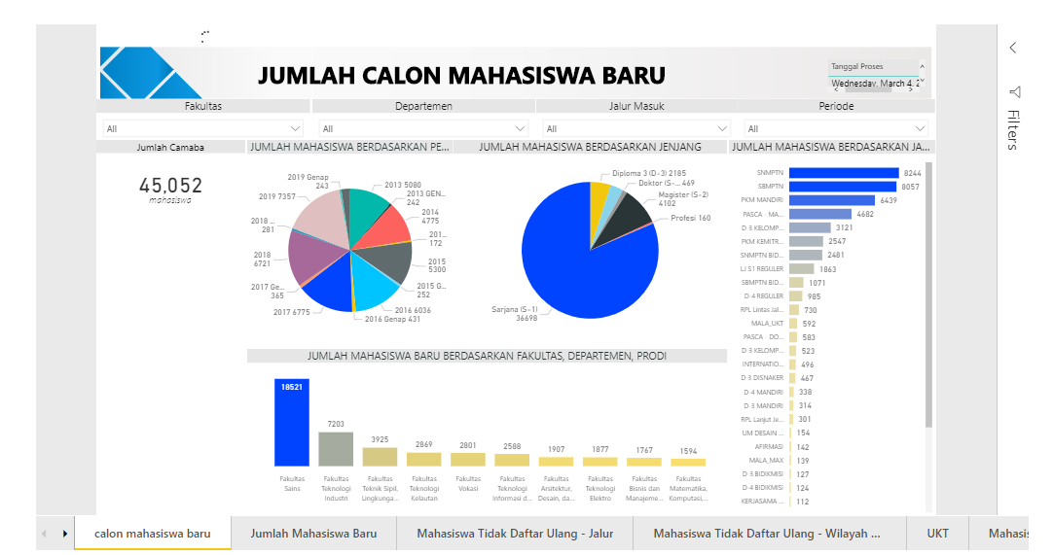
Example of Data Utilization
Data
New student
(name, department, gender, level, etc)
Information
Number of new student in each dept
Number of new student in each level
This information can be used by the University to:
Decide no class
Allocate lecturers
Etc

Slide 17

Any other examples ?

Slide 18

Database
A database is an organized collection of data stored and accessed electronically

Slide 19
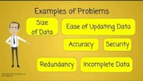
Why do we need database?

Slide 20
Types of Database
Structured database
Free-form database
It is also called the structured data in which a record or file of information arranged in uniform format. These databases are usually storage of information with similar entries such as a list of persons born in a country, a medical database of patients’ data, an inventory database of a company and many others
It is a loose collection of information, such as those you will find on the World Wide Web. A collection of your documents in the computer made from several programs can be considered as free-form database

Slide 21
Types of Database (2)
Operational database
Analytical database
It is a dynamic database that is used by any organization in its day-to- day operation. They are used to collect data, maintain, modify and delete data
It is a static database, where data is rarely modified. This database is often used to store and track historical data to make long term projections and analysis.

Slide 22
- THANK YOU-

